Slide 1
Whiteness Rules: Racial Exclusion in Becoming an American College President

Slide 2
Agenda
Welcome
Introduction to the Work
Presentation of Research Findings and Solutions
Advancing Change
Q&A

Slide 3
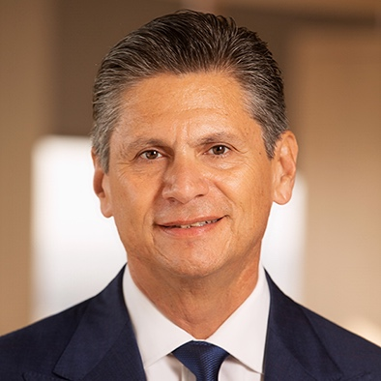
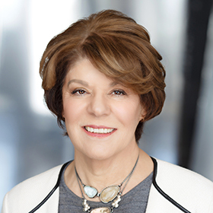
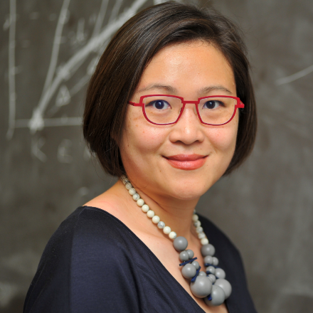
Our Presenters
Eloy Ortiz Oakley
President and CEO
College Futures Foundation
Estela Mara Bensimon, Ed.D
University Professor Emerita, Founding Director, Center for Urban Education, USC; President of Bensimon & Associates
Megan M. Chase, Ph.D
Education & Policy Research Consultant, Megan Chase Consulting, LLC;
Researcher with Bensimon & Associates
Cheryl D. Ching, Ph.D
Assistant Professor of Higher Education at the University of Massachusetts, Boston; Researcher with
Bensimon & Associates

Slide 4
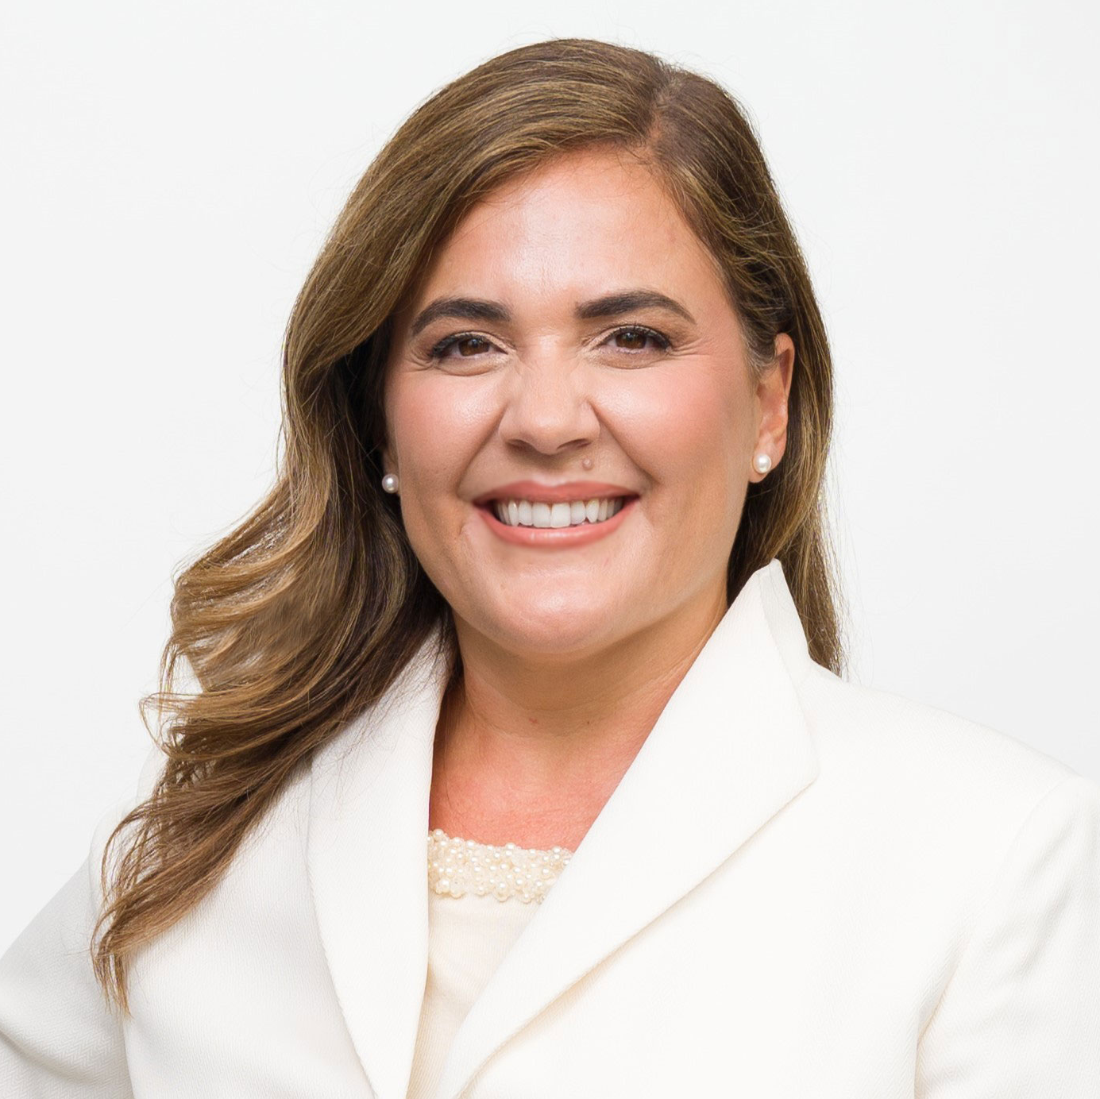
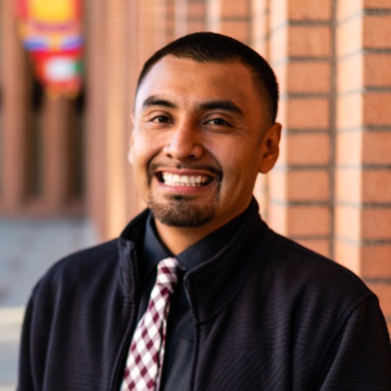
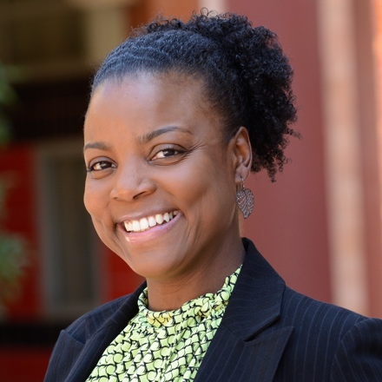
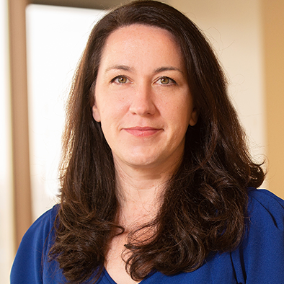
Our Presenters
Michele Siqueiros
President
Campaign for College Opportunity
Román Liera, Ph.D
Assistant Professor of Higher Education at Montclair State University; Researcher with Bensimon & Associates
Raquel M. Rall, Ph.D
Associate Professor of Higher Education at the University of California, Riverside;
Researcher with Bensimon & Associates
Regan Douglass
Director of Strategic Communications
College Futures Foundation

Slide 5
About College Futures Foundation
We believe there is nothing more transformative for individuals, our economy, and our society than educational opportunity, and that the pathway to a college degree should be clear and open to the diverse students of California.
Our Mission: We work to ensure that more students who reflect California’s diversity complete a B.A. and access the opportunity for a better life. We believe this is best accomplished when California’s education system is designed to meet students’ needs, dedicated to fulfilling their aspirations, and ensures equitable outcomes.
More graduates for a thriving California

Slide 6
The Reports
Findings Report
Toolkit

Slide 7
Key Findings
1
2
3
4
Presidential Candidates of Color Must Conform to the White Archetype
Qualified Candidates of Color Must Dodge the Racial Bias Battlefield
Presidents and Candidates of Color Are Burdened With Double Consciousness
White Rules Are Hidden in Plain Sight
5
6
7
8
Search Committees Perpetuate Veiled Racial and Gender Bias
Executive Search Firms May Talk the Talk, but Are Nowhere Near Walking the Walk
Most Presidential Job Announcements Miss the Mark on Racial Equity
Boards Make or Break Racial Equity in Presidential Hiring

Slide 8
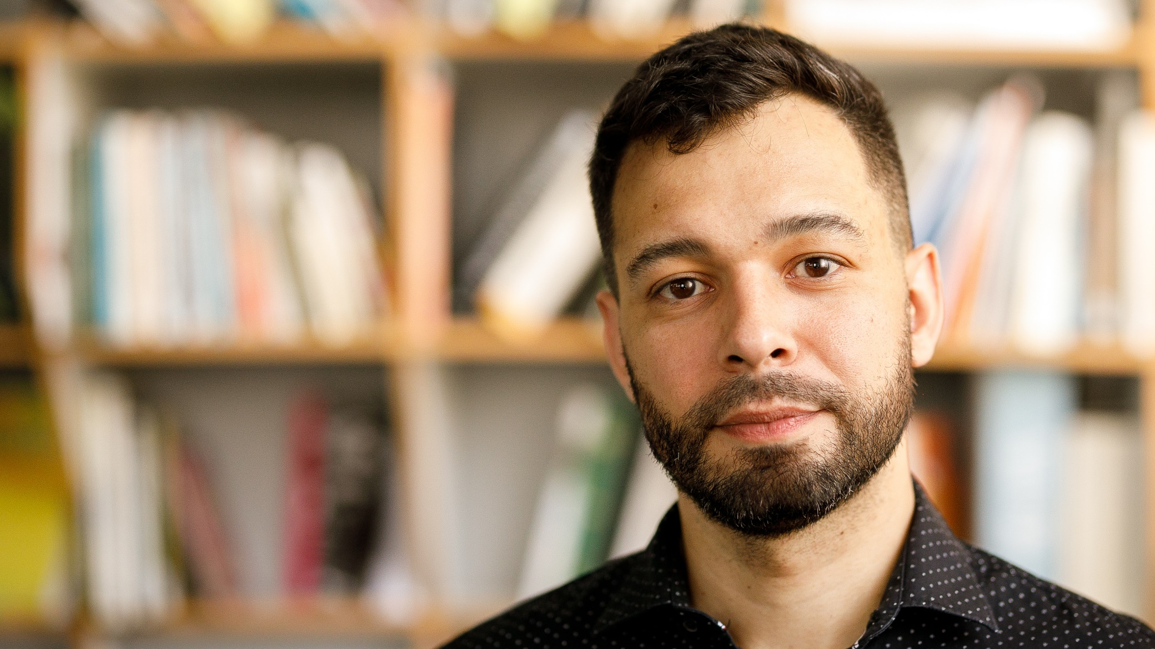
What Can We Do?

Slide 9
The Solutions Are…
NOT more outreach
NOT more leadership training
NOT more mentoring
NOT more elitism
NOT more one-day trainings
And NOT ONLY at the presidential level
If we continue to do what has always been done, we cannot be shocked when we get the same results

Slide 10
Overview
WHAT IS THE TOOLKIT…
WHAT THE TOOLKIT IS NOT…
A place to start.
A guide that addresses five aspects of the presidential search process that are critical for de-whitening the presidency.
Tools to implement in your next search.
Ideas and recommendations to reform existing rules, processes, and structures.
A miracle worker. Racial equity is hard work; stakeholders will need to engage with the tools, have challenging conversations and (as always) consider the unique context of their institution.
Exhaustive. There are details of the presidential search and appointment process that go far beyond the scope of this toolkit.

Slide 11
Tools at a Glance
1
2
3
4
5
Hiring Critically Race-Conscious Search Firms
Centering Racial Equity in Search Committee Formation
Training Search Committees for Racial Equity in Presidential Hiring
Ensuring Racial Equity in Search Committee Work
Using the Presidential Job Announcement Tool
Recommendations
for establishing racial equity as a criterion for ESF selection.
Recommendations for advancing racial equity while working
with the current logic of stakeholder representation in composing search committees.
Additional topics for search committee training, beyond
compositional diversity and (general) implicit bias.
Recommendations for centralizing accountability and
transparency in presidential search, specifically as it relates to evaluation, deliberation,
and decision-making.
A guide to making a critical assessment of job announcements for their integration of racial equity and equity-mindedness.

Slide 12
TOOL 4
Evaluation and Accountability: Ensuring Racial Equity in Search Committee Work

Slide 13
Ensuring Racial Equity in Search Committee Work
Why focus on search committee work?
Search committee work is critical to interviewee selection and who ultimately moves forward.
Search committee work is often behind closed doors.
Search committee members are composed of various stakeholders that hold more or less power—attending to power dynamics is critical.

Slide 14
Ensuring Racial Equity in Search Committee Work
What is this tool?
Seven recommendations for centralizing accountability and transparency in evaluation, deliberation, and decision making
Who is the audience?
Search committees
Recommendations/Tools
How does the tool advance racial equity?

Slide 15
Ensuring Racial Equity in Search Committee Work
RECOMMENDATION #3:
Expand qualified leadership pathways and center equity-mindedness in candidate qualifications
TOOL:
Criteria | Traditional Approach | Equity-Minded Approach
Leadership Experience | Number of years in senior leadership positions | Experience creating, organizing, and/or leading programs that advance racial equity and anti-racism; track record with hiring practitioners who are critically race conscious and equity-minded
Fiscal Management | Experience managing budgets | Experience raising money and/or budgeting for initiatives that advance racial equity
Professional Pathways | Academic leadership pathways (e.g., faculty, department chair, dean, provost) | Equal consideration given for non-academic leadership pathways (e.g., vice president of student services; director of opportunity programs; non-profit sectors)
Professional Development | Not central/ not prioritized; participated in traditional leadership programs | Participated in leadership programs focused on developing Leaders of Color, as well as seminars, workshops, and initiatives that develop their knowledge and capacity to be critically race-conscious leaders and to create anti-racist and racial-equity opportunities for the institution
Use an equity-minded lens to identify criteria that can increase the likelihood of identifying and hiring a president who will exercise leadership in critically race-conscious ways.
How does the tool advance racial equity?
Search committees that prioritize equity-minded leadership qualifications are better positioned to see how Candidates of Color can advance racial equity on their campus.
See Table 6. Page 28 of The Toolkit

Slide 16
Advancing Change

Slide 17
Discussion

Slide 18
Thank You
Questions for the Researchers?
Questions or comments about the work?
Megan M. Chase, Ph.D
Researcher mchaseconsult@gmail.com
Estela Mara Bensimon, Ed.D
President bensimon@usc.edu
Regan Douglass
Director of Strategic Communications
rdouglass@collegefutures.org
415-287-1822
@CollegeFutures
Find the report and toolkit now our website
at www.collegefutures.org/whitenessrulesreport

Slide 19
Whiteness Rules: Racial Exclusion in Becoming an American College President

Slide 20
Additional Slides

Slide 21
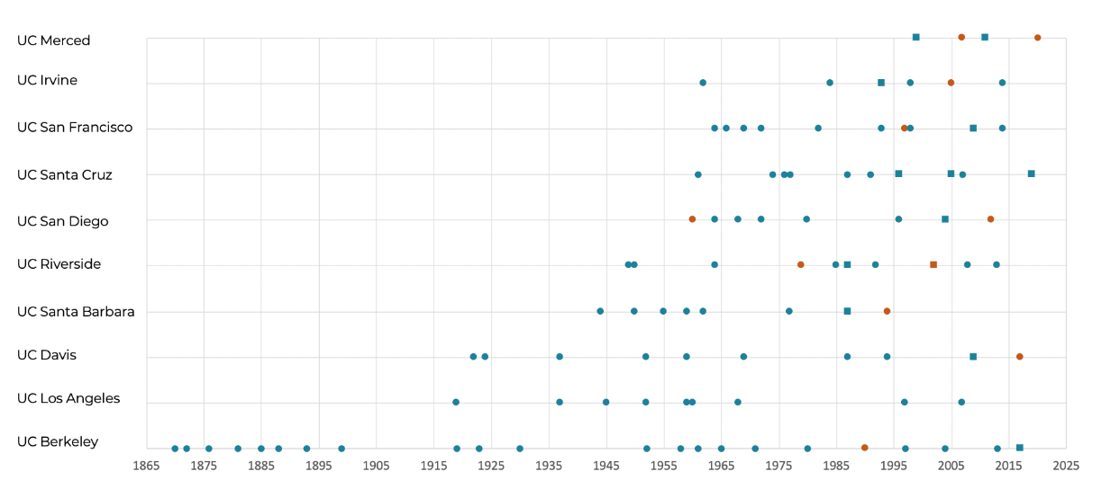
The California Presidency: UC Historical Data
See Figures 1 – 3. Pages 10 – 11 of the Findings Report.

Slide 22
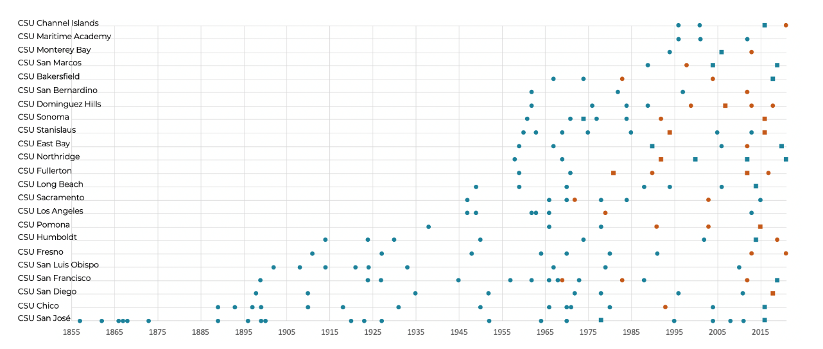
The California Presidency: CSU Historical Data
See Figures 1 – 3. Pages 10 – 11 of the Findings Report.

Slide 23
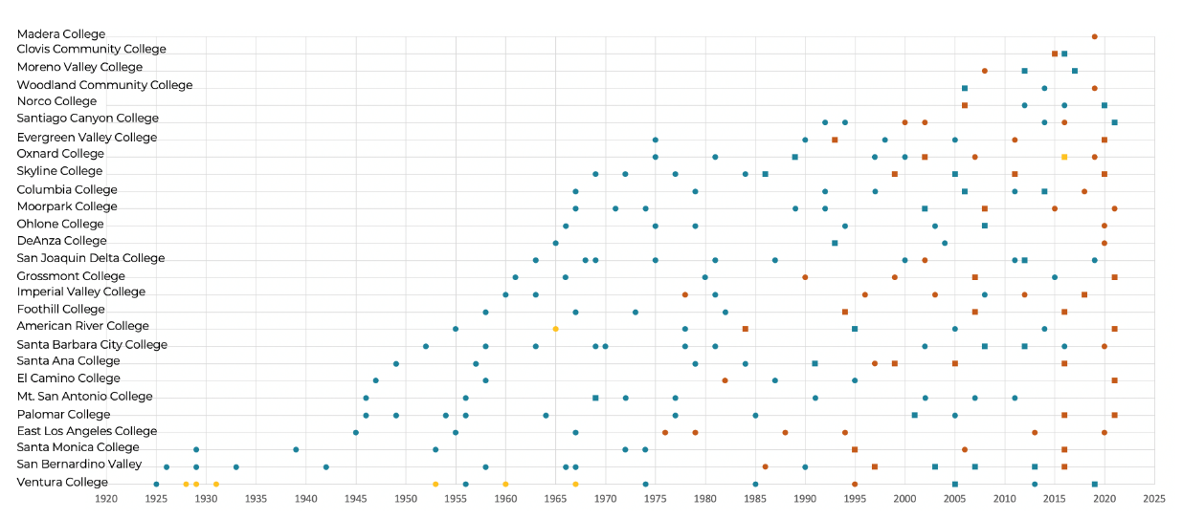
The California Presidency: CCC Historical Data
See Figures 1 – 3. Pages 10 – 11 of the Findings Report.

Slide 24
Public Higher Education Presidents/Chancellors in California, by Race and Gender, 2021
UC CSU CCC
See Figures 4, 8. Pages 12 – 13 of the Findings Report.

Slide 25
The California Presidency Today: Race
White
Asian
Latinx
Black or African American
Two or More Races
Unknown
See Figures 5 – 7. Pages 12 of the Findings Report.

Slide 26
Methodology

Slide 27
Research Questions
In what ways are presidential search practices in California’s three public sectors racialized?
How do presidential search practices that result in the hiring of Black, Latinx, Asian, Pacific Islander, or Indigenous leaders compare to those that lead to white leader appointments?
How do the pathways of Black, Latinx, Asian, Pacific Islander, or Indigenous appointed leaders compare to those of white leader appointments?
How does whiteness and racialization in presidential search and appointment processes shape hiring outcomes?

Slide 28
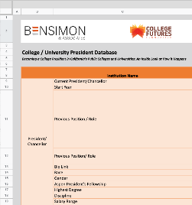
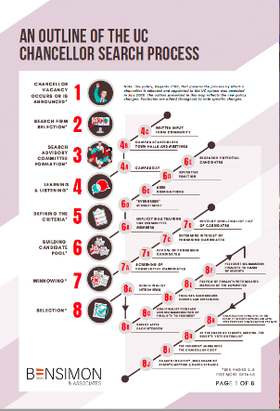
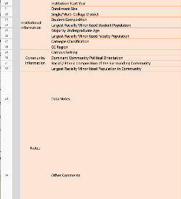
Methods: What We Did
PHASE 1:
Understanding the current and historical presidential landscape in California
California President/ Chancellor Database
UC, CSU, CCC President/ Chancellor Search and Appointment Process Maps
Database creation
Mapping the Presidential search and appointment process
Preliminary interviews (13)—trustees, current/former presidents, system administrators, and external consultants
Pages 43 – 46 of the Findings Report.

Slide 29
Methods: What We Did
PHASE 2:
Capturing presidential experiences: In-depth case studies of selection and appointments in the three sectors
Role | Number
Presidents of Color | 20
White Presidents | 16
System Administrators (Current/Former) | 4
Trustees | 1
Out-of-State Presidents (Current/Former) | 2
White Search Firm Consultants | 6
Search Firm Consultants of Color | 4
Community Members | 1
Interviews (54)
Presidential curriculum vitae document analysis (35)
Job announcement analysis (38)
Pages 46 – 48 of the Findings Report.

